Slide 1
Deep Generative Models
Shen Bingquan <sbingqua@dso.org.sg>
National University of Singapore :: School of Engineering :: Engineering Science Programme

Slide 2
Contents
What are Deep Generative Models (DGMs)?
Types of DGMs
Fully Observable Likelihood models
Autoregressive Models
Normalizing Flows Models
Latent Variable Models
Variational Autoencoders (VAEs)
Implicit Generative Models
Generative Adversarial Networks (GANs)
Current Challenges

Slide 3
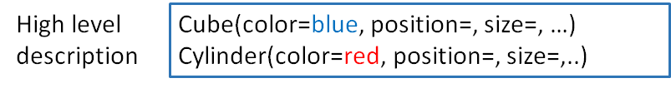
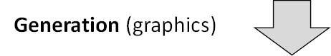
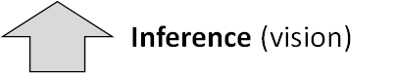
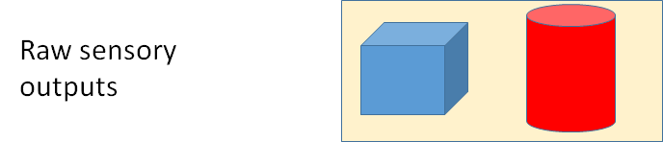
Generative Modeling in Computer Graphics
How to generate natural images with a computer?
Slide from http://cs236.stanford.edu/syllabus.html
Notes:
Vision:
Given images with noise, estimate physical quantities (ill-posed problem)

Slide 4
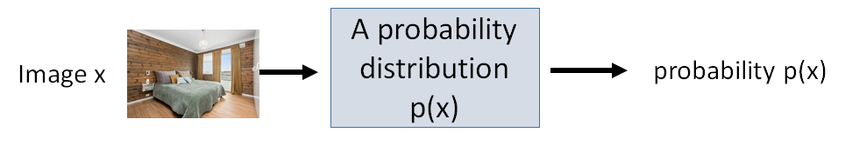
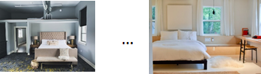
Statistical Generative Models
A statistical generative model is a probability distribution p(x)
Data: samples (e.g., images, sentences, speeches)
Prior knowledge: parametric form (e.g., Gaussian?), loss function (e.g., maximum likelihood?), optimization algorithm, etc.
It is generative because sampling from p(x) generates new images
Question: Can we reduce the amount of prior knowledge and learn from data?
Note: Cannot do something purely based on data. Sample complexity scales exponentially. Requires some Inductive Bias.
Slide from http://cs236.stanford.edu/syllabus.html
Locatello, F., Bauer, S., Lucic, M., Raetsch, G., Gelly, S., Schölkopf, B., & Bachem, O. (2019, May). Challenging common assumptions in the unsupervised learning of disentangled representations. In international conference on machine learning (pp. 4114-4124).

Slide 5
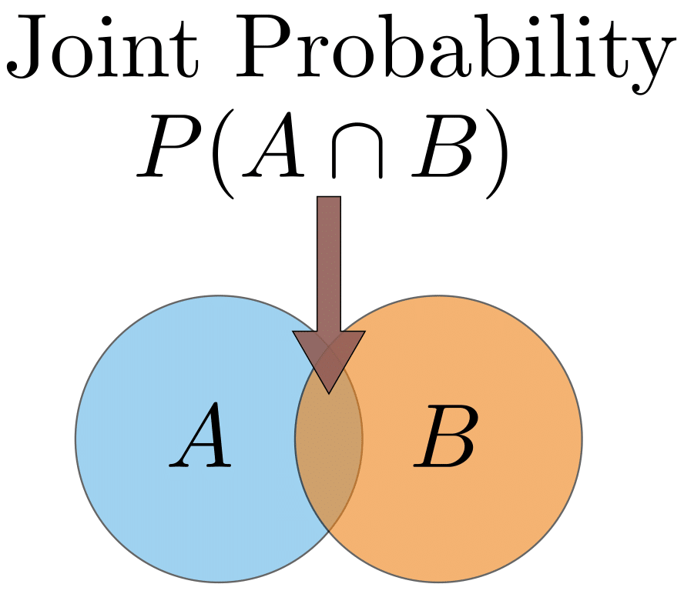
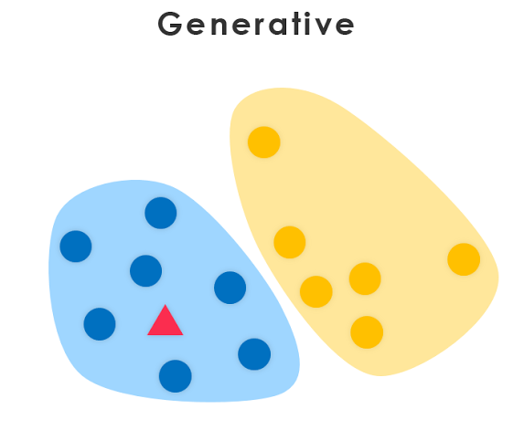
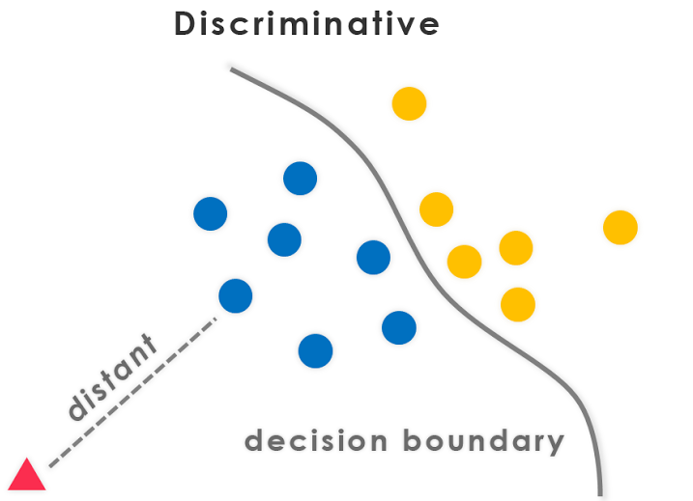

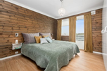

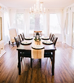
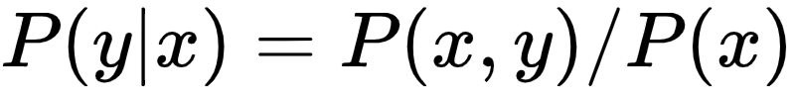
Discriminative vs. generative
Models the actual distribution of each class and learns the joint probability distribution p(x,y). Predicts the conditional probability with Bayes Theorem.
Models the decision boundary between the classes and learns the conditional probability distribution p(y|x).
Slide adapted from http://cs236.stanford.edu/syllabus.html
https://medium.com/@data_datum/deep-learning-in-5-minutes-part-3-discriminative-vs-generative-models-8b27c616b8af

Slide 6
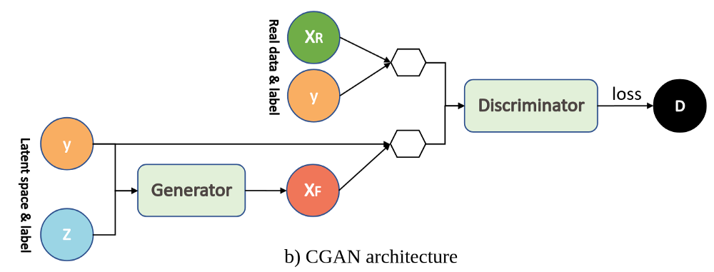
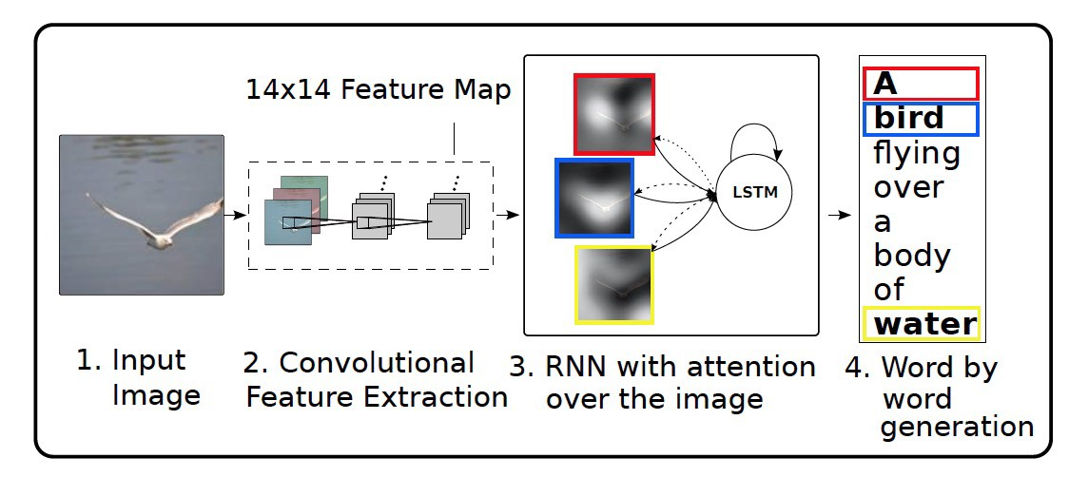
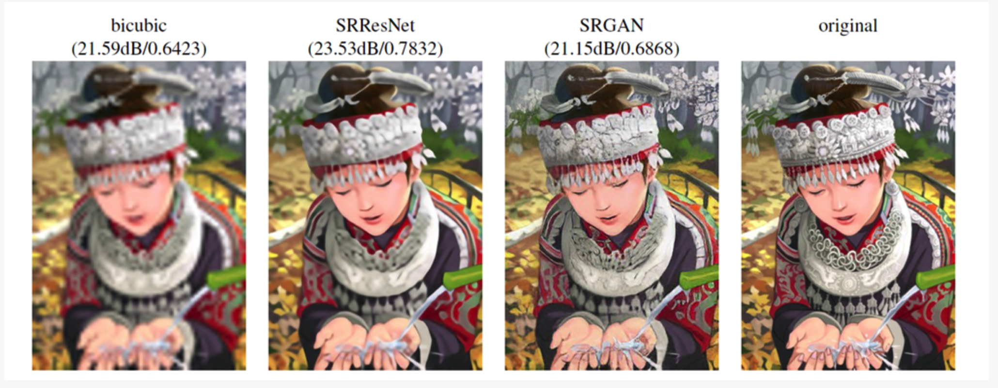
Conditional Generative Models
Often useful to condition on rich side information Y.
Image source https://mc.ai/a-tutorial-on-conditional-generative-adversarial-nets-keras-implementation/, Slide adapted from http://cs236.stanford.edu/syllabus.html
Ledig, Christian, et al. "Photo-realistic single image super-resolution using a generative adversarial network." Proceedings of the IEEE conference on computer vision and pattern recognition. 2017.
Xu, Kelvin, et al. "Show, attend and tell: Neural image caption generation with visual attention." International conference on machine learning. 2015.

Slide 7
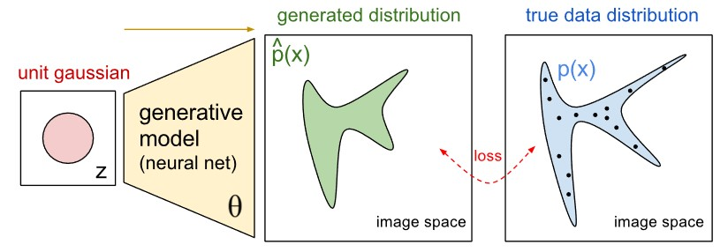
What are Deep Generative Models?
Deep generative models aim to combine the interpretable representations and quantified uncertainty offered by probabilistic models, with the flexibility and scalable learning of deep neural networks.
http://stat.columbia.edu/~cunningham/teaching/GR8201/

Slide 8

Types of Deep Generative Models
Autoregressive Models
Variational Autoencoders (VAEs)
Normalizing Flow Models
Generative Adversarial Networks (GANs)
Autoregressive Models:
Minimize negative log-likelihood
Image source https://colah.github.io/posts/2015-08-Understanding-LSTMs/

Slide 9
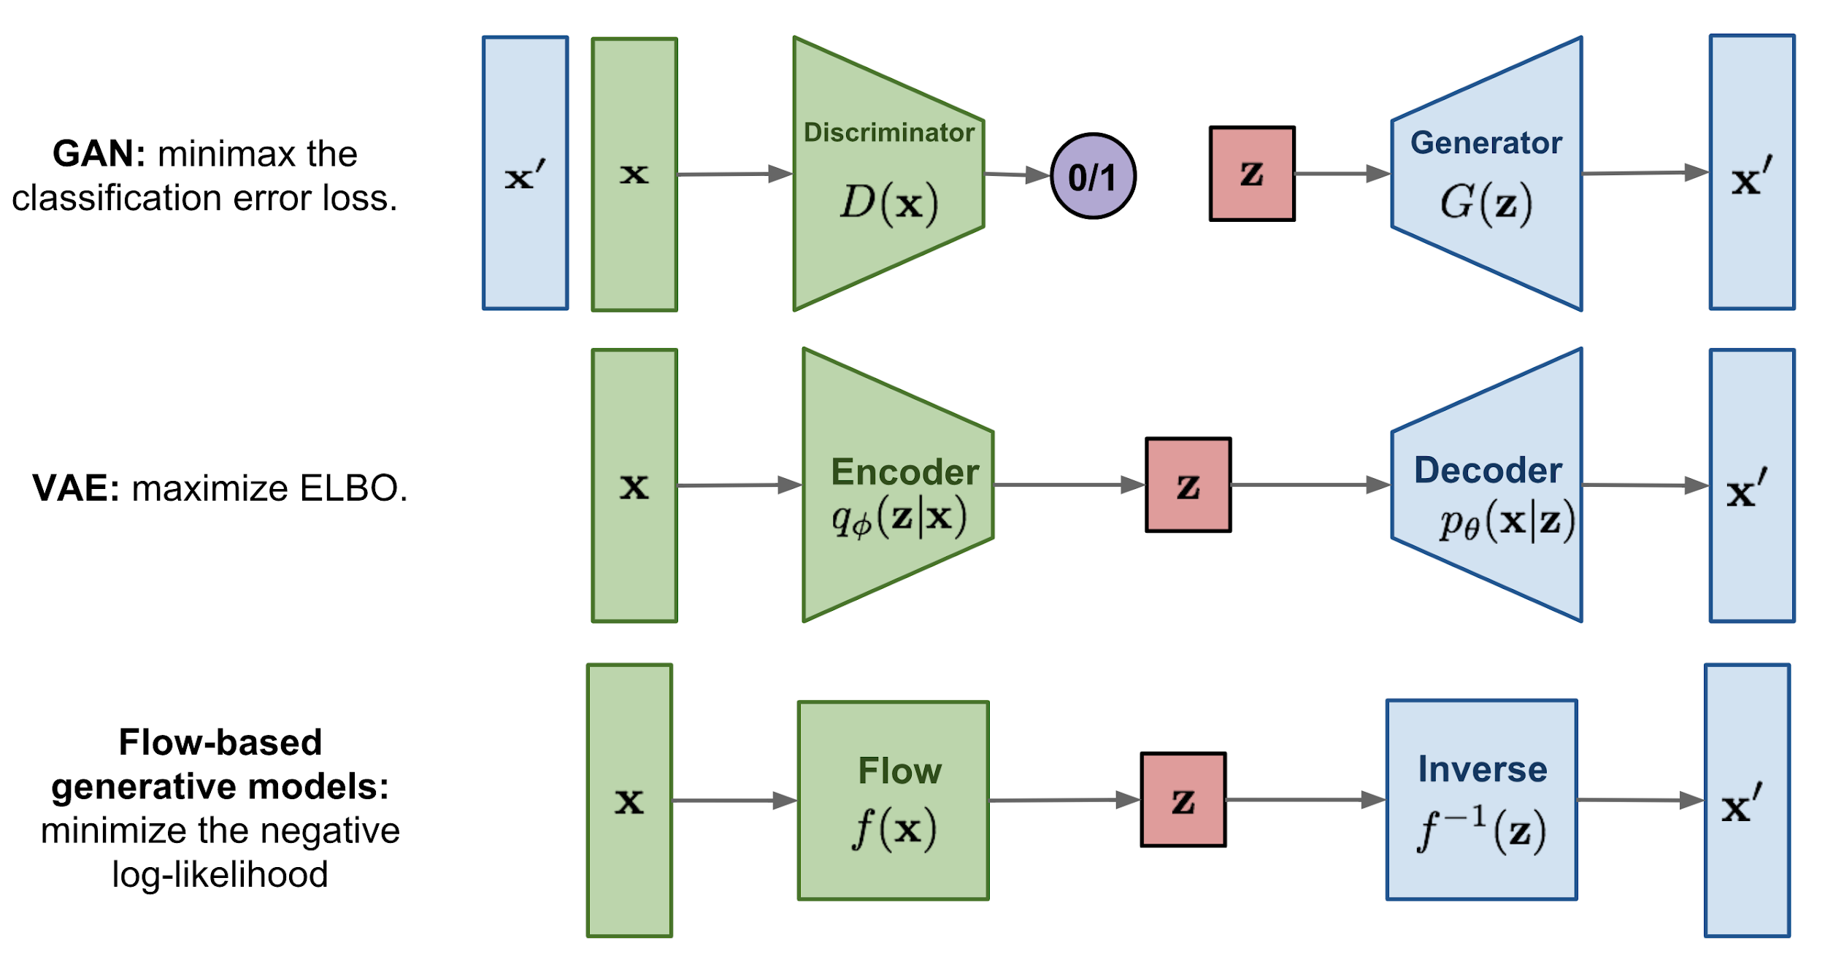
Types of Deep Generative Models

Slide 10
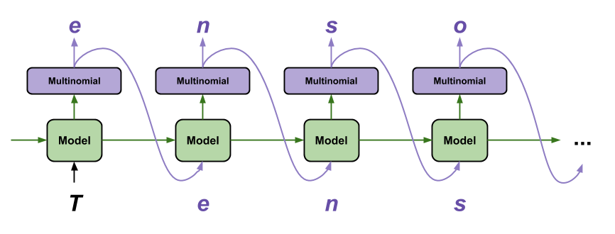
Autoregressive Models
Using parameterized functions (e.g., logistic regression above) to predict next pixel given all the previous ones.
Using chain rule:

Slide 11
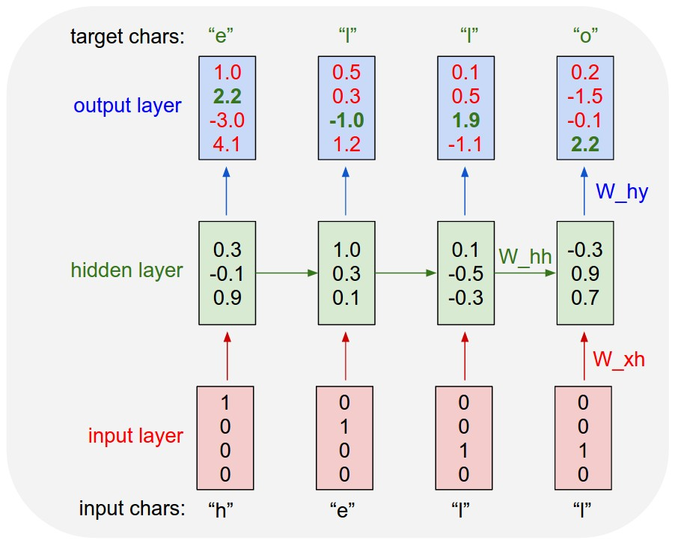
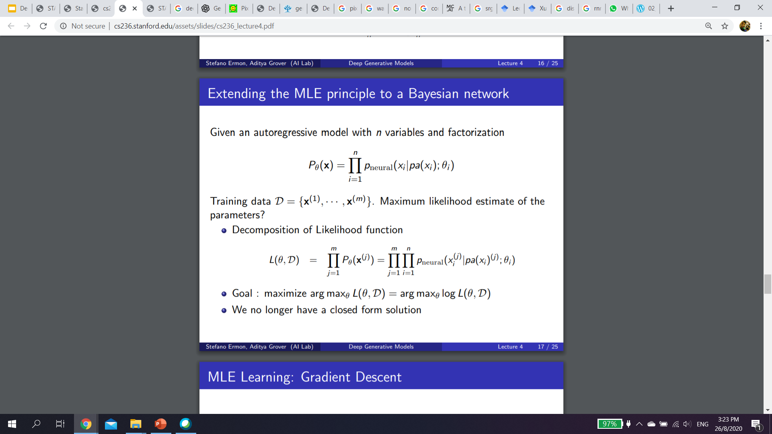
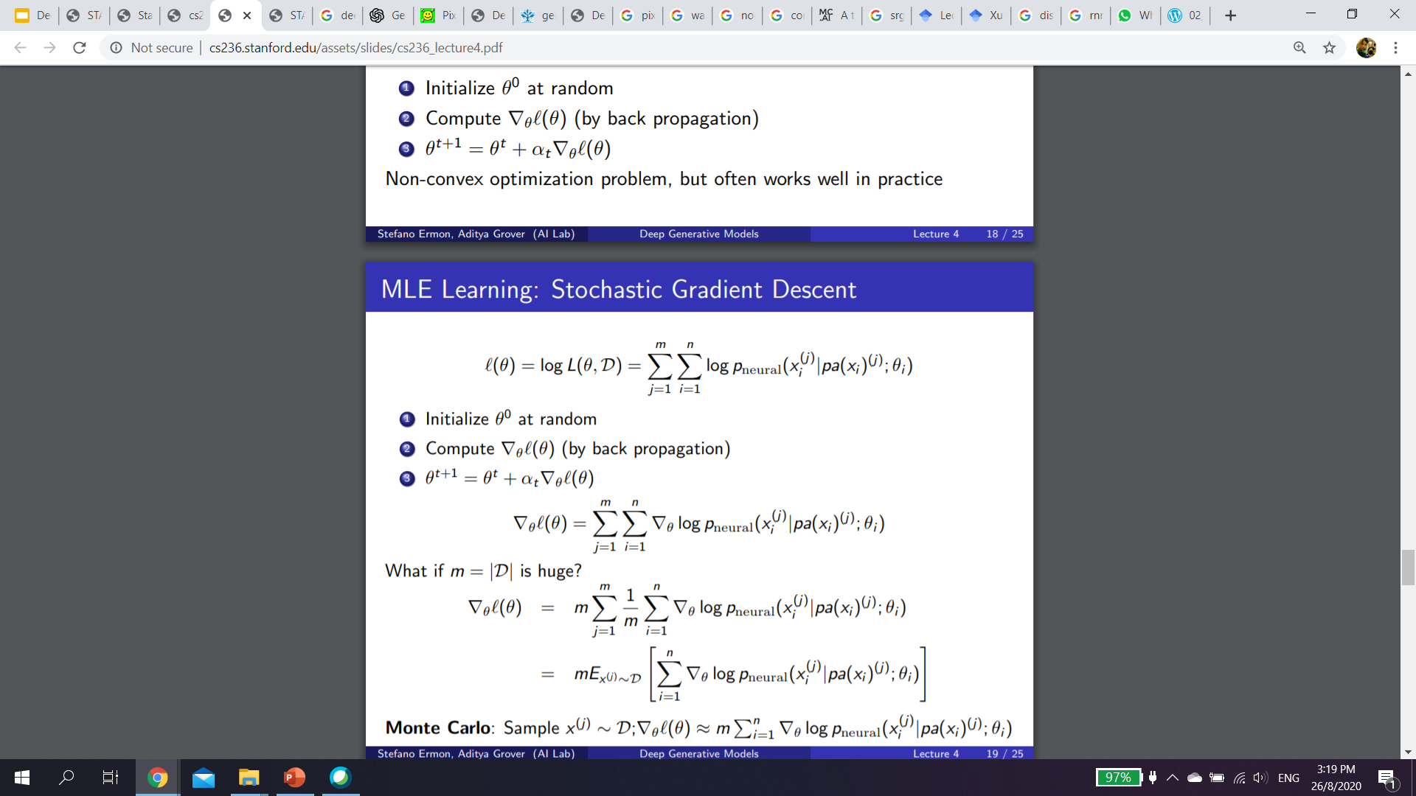
Autoregressive Models
Train with Empirical risk minimization (ERM).
Given m data with sequence length of of n:
Goal to maximise
ERM can easily overfit the data. E.g. the model memorise all the training.
To generalize the model should generalize well to “never-seen” samples.
Slide adapted from http://cs236.stanford.edu/syllabus.html
Notes:
Should regularize the weights

Slide 12
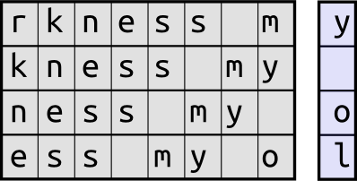
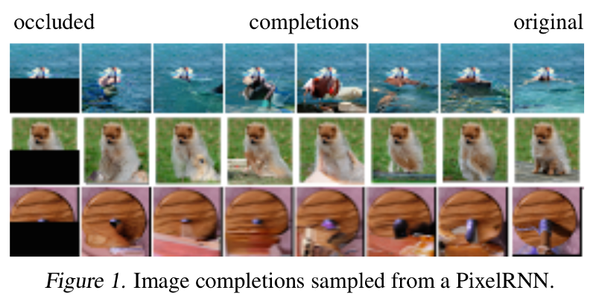
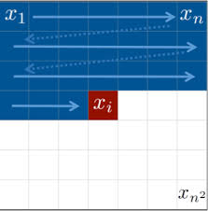
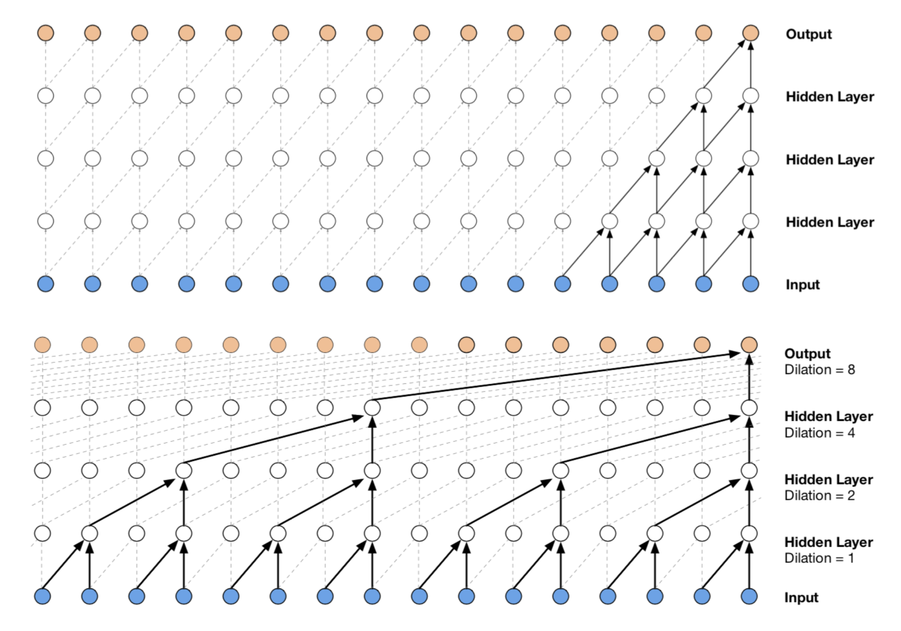
Examples of Autoregressive Models
“The surprised in investors weren’t going to raise money. I’m not the company with the time there are all interesting quickly, don’t have to get off the same programmers. There’s a super-angel round fundraising, why do you can do. If you have a different physical investment are become in people who reduced in a startup with the way to argument the acquirer could see them just that you’re also the founders will part of users’ affords that and an alternation to the idea. [2] Don’t work at first member to see the way kids will seem in advance of a bad successful startup. And if you have to act the big company too.”
Char-RNN by Andrej Karpathy
Pixel-RNN / CNN
WaveNet
GPT-1/2/3
https://github.com/karpathy/char-rnn
Oord, Aaron van den, Nal Kalchbrenner, and Koray Kavukcuoglu. "Pixel recurrent neural networks." arXiv preprint arXiv:1601.06759 (2016).
Oord, Aaron van den, et al. "Conditional image generation with pixelcnn decoders." Advances in neural information processing systems. 2016.
Oord, Aaron van den, et al. "Wavenet: A generative model for raw audio." arXiv preprint arXiv:1609.03499 (2016).
Brown, Tom B., et al. "Language models are few-shot learners." arXiv preprint arXiv:2005.14165 (2020).
Parametric Concatenative Wavenet

Slide 13
Autoregressive Models
Autoregressive models:
Chain rule based factorization is fully general
Compact representation via conditional independence and/or neural parameterizations
Pros:
Easy to evaluate likelihoods
Easy to train
Cons:
Requires an ordering
Generation is sequential
Cannot learn features in an unsupervised way
Slide adapted from http://cs236.stanford.edu/syllabus.html

Slide 14
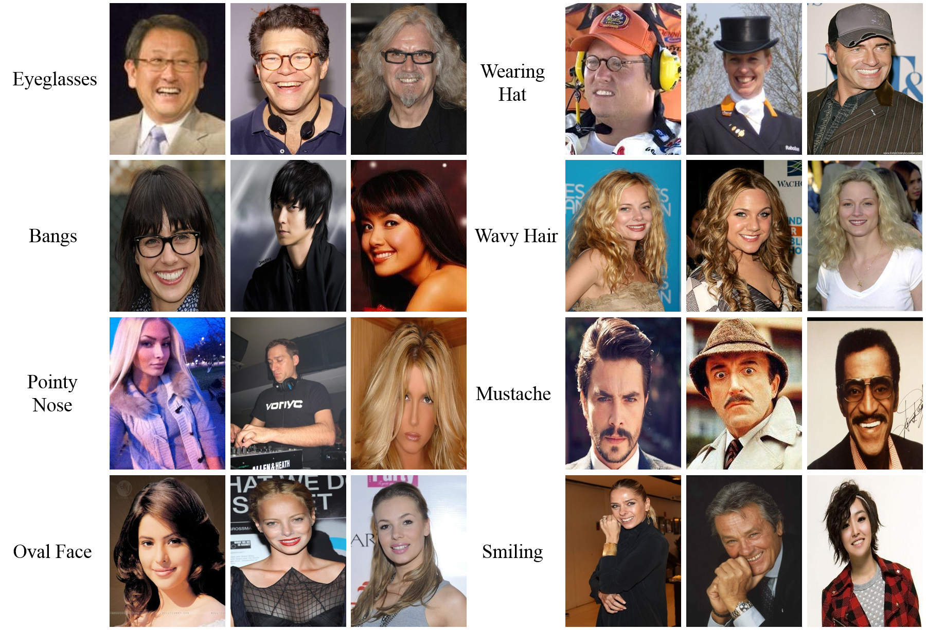
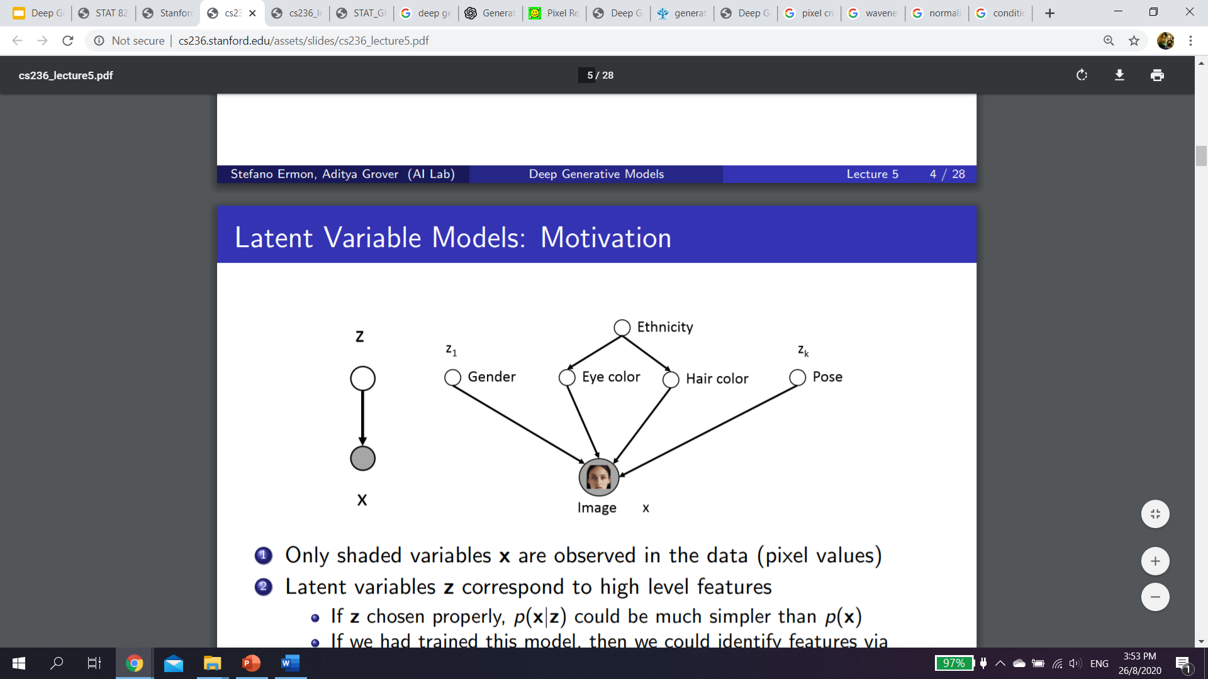
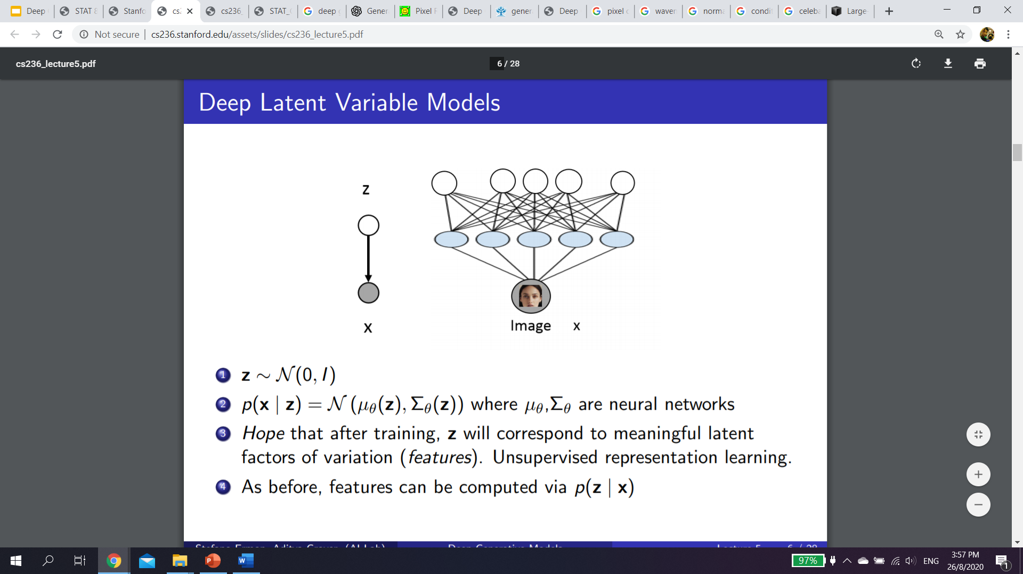
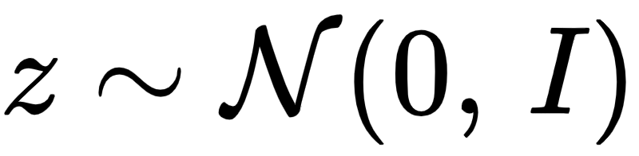
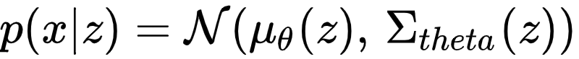
Latent Variable Models
Lots of variability in images x due to gender, eye color, hair color, pose, etc.
Can we explicitly model these factors using latent variables z?
Hard to manually specify these conditions.
Hope a Neural Network can learn them from data x.
Let
Features z can be computed via some function q(z | x)
CelebA dataset http://mmlab.ie.cuhk.edu.hk/projects/CelebA.html
Slide adapted from http://cs236.stanford.edu/syllabus.html

Slide 15
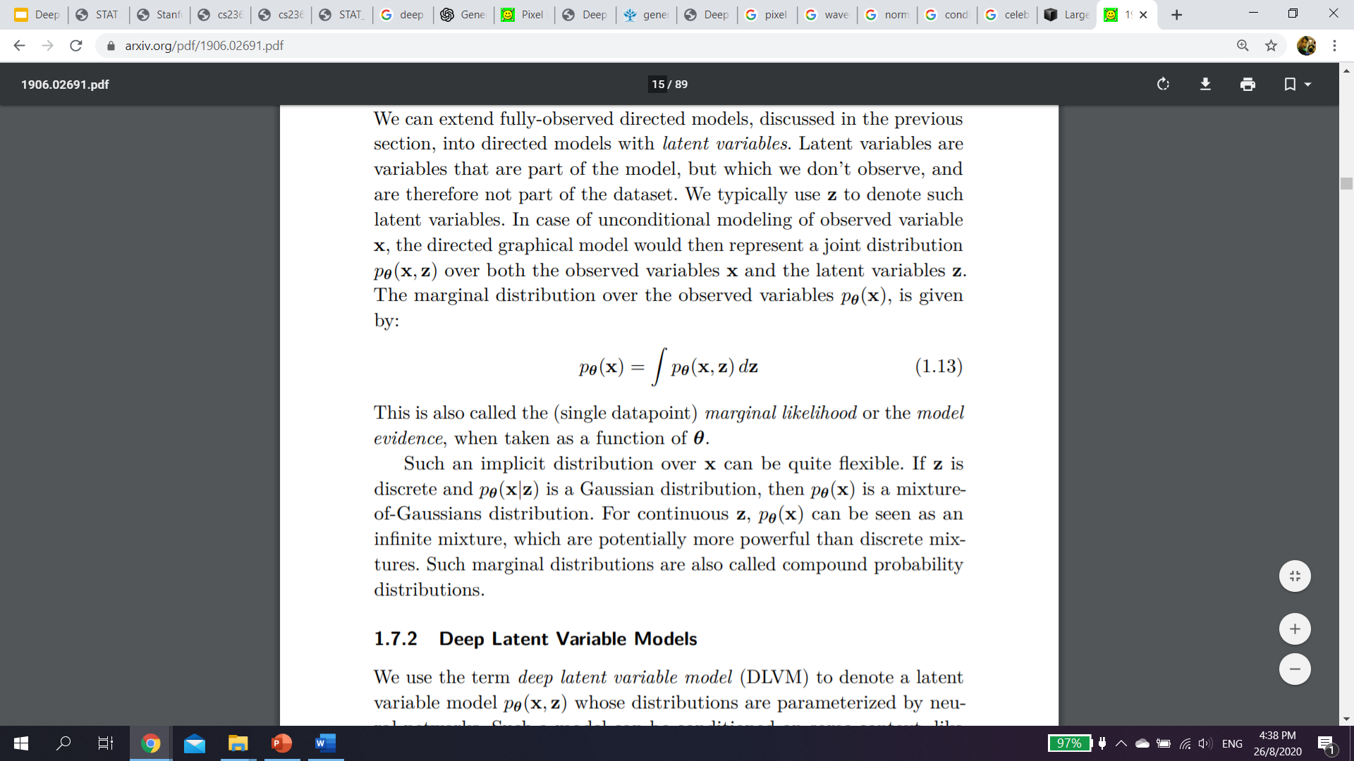
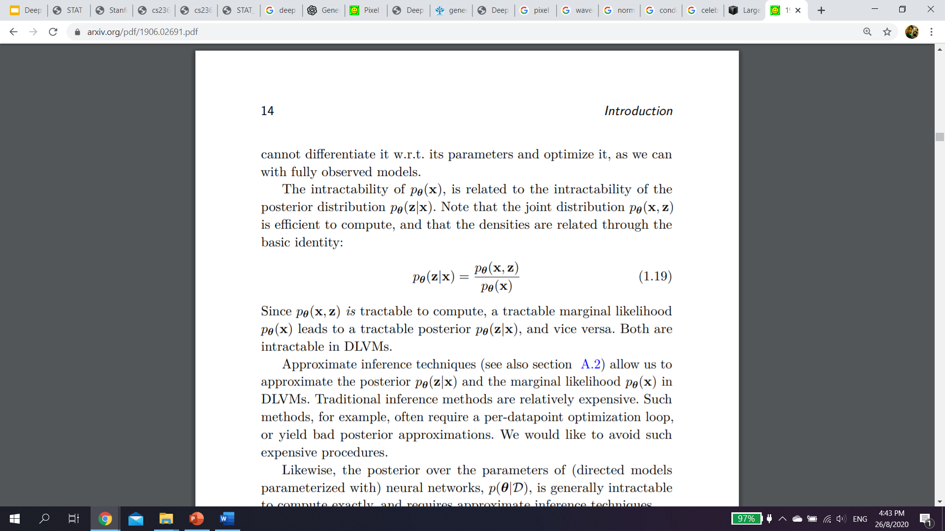
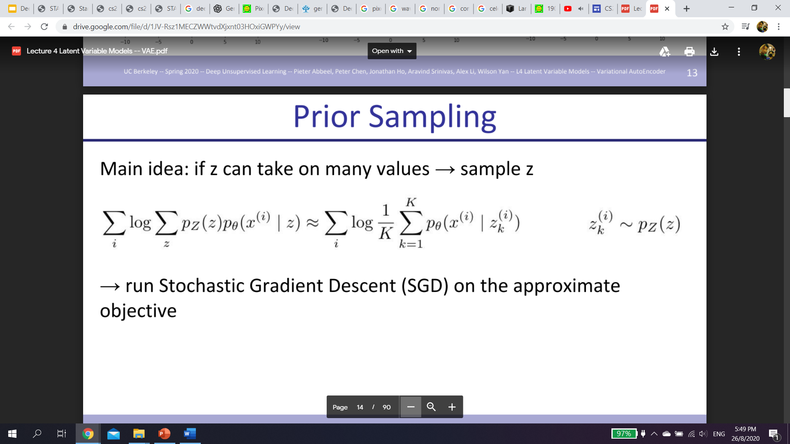
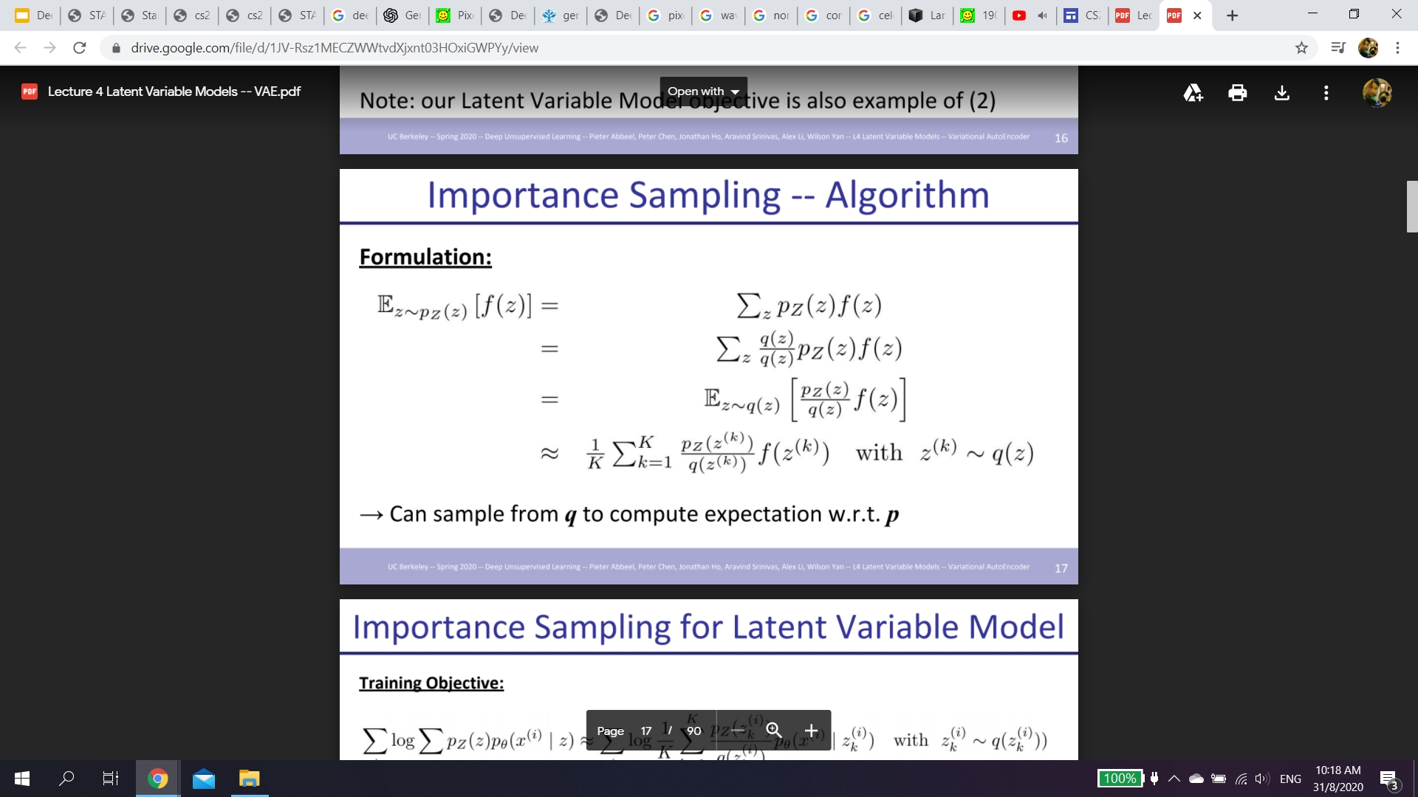
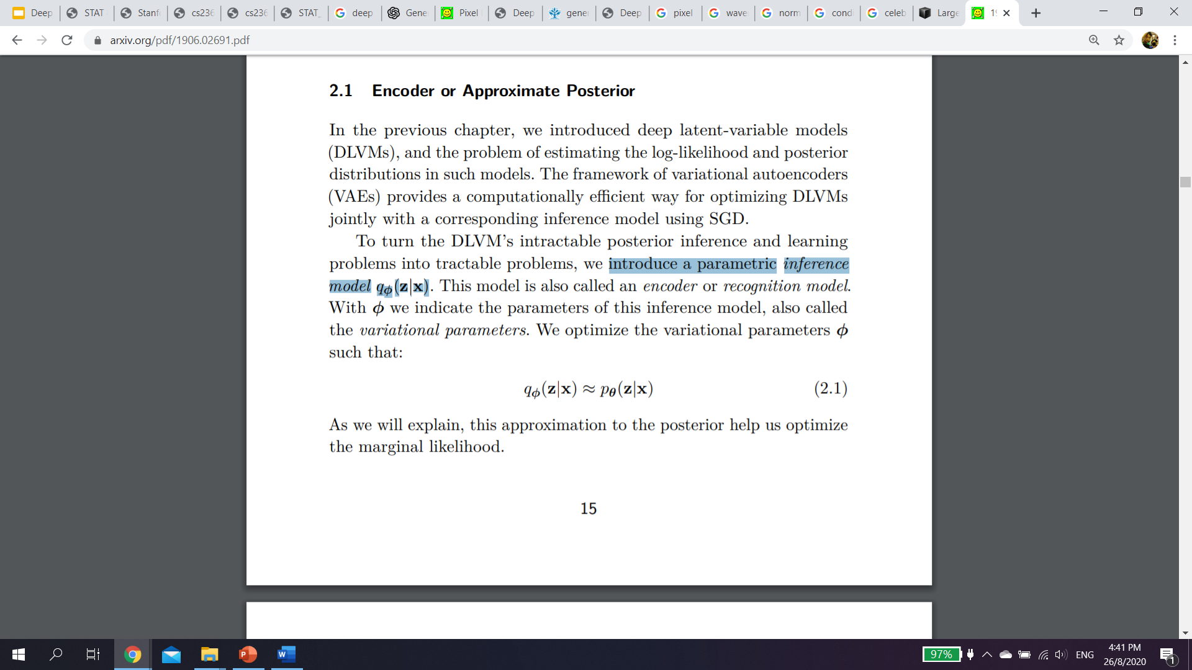
Marginal Likelihood of Latent Variable Models
The marginal distribution over the observed variables is given by:
Could be rewritten as
Approximate:
Prior Sampling
Importance Sampling
Introduce a parametric inference model such that
Use this approximation to the posterior help us optimize the marginal likelihood.
Intractable to compute for large enumerations of z
For high d, near impossible to sampled a z that is a good match.
Still intractable
Kingma, D. P., & Welling, M. (2019). An introduction to variational autoencoders. arXiv preprint arXiv:1906.02691.
Slides adapted from https://sites.google.com/view/berkeley-cs294-158-sp20/home

Slide 16
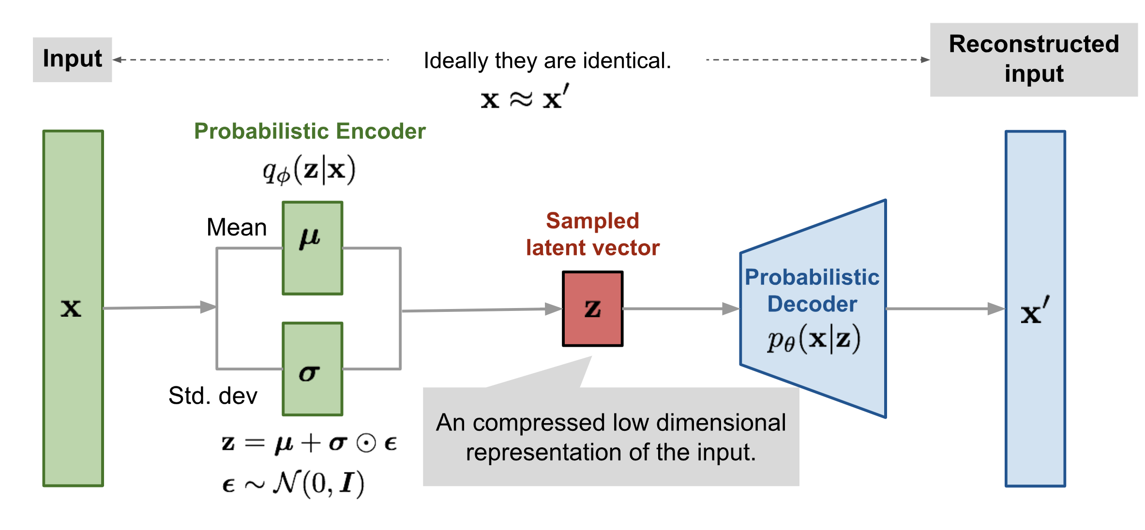
Variational Autoencoder (VAE)
Kingma, D. P., & Welling, M. (2013). Auto-encoding variational bayes. arXiv preprint arXiv:1312.6114.
Notes:
Beta hyperparameter in front of the KL regularizer of vanilla VAEs to constrain the capacity of the VAE bottleneck.
If Beta = 1, Beta VAE = Vanilla VAE
If Beta > 1, it applies a stronger constraint on the latent bottleneck and limits the representation capacity of z.
Factor VAE: Encourage independent across the latent dimensions

Slide 17
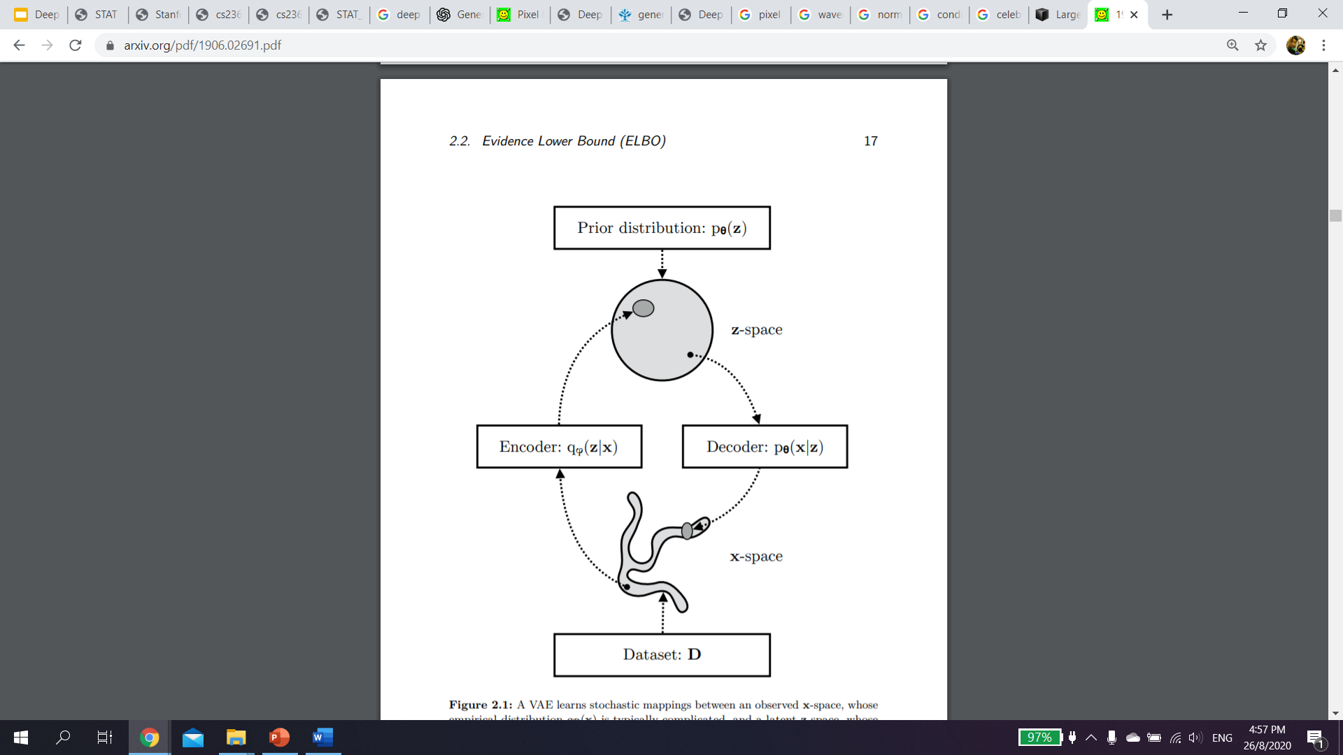
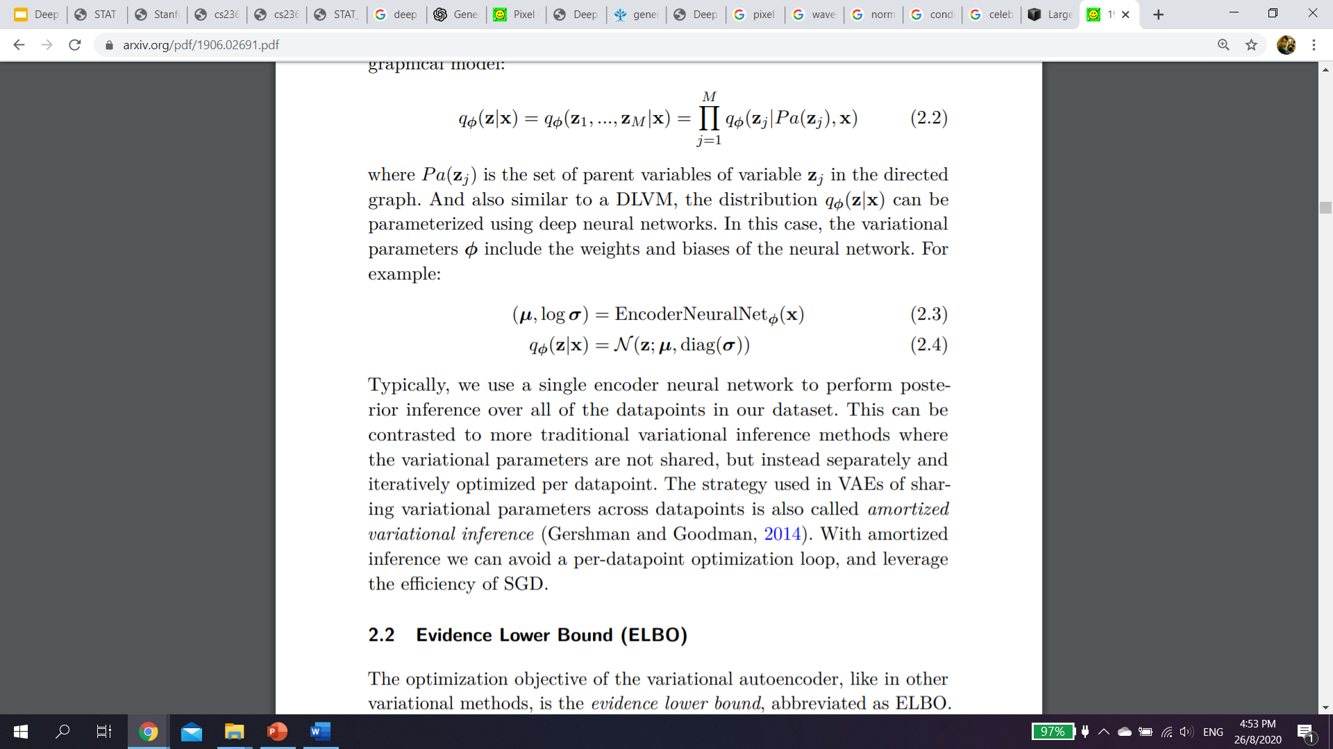
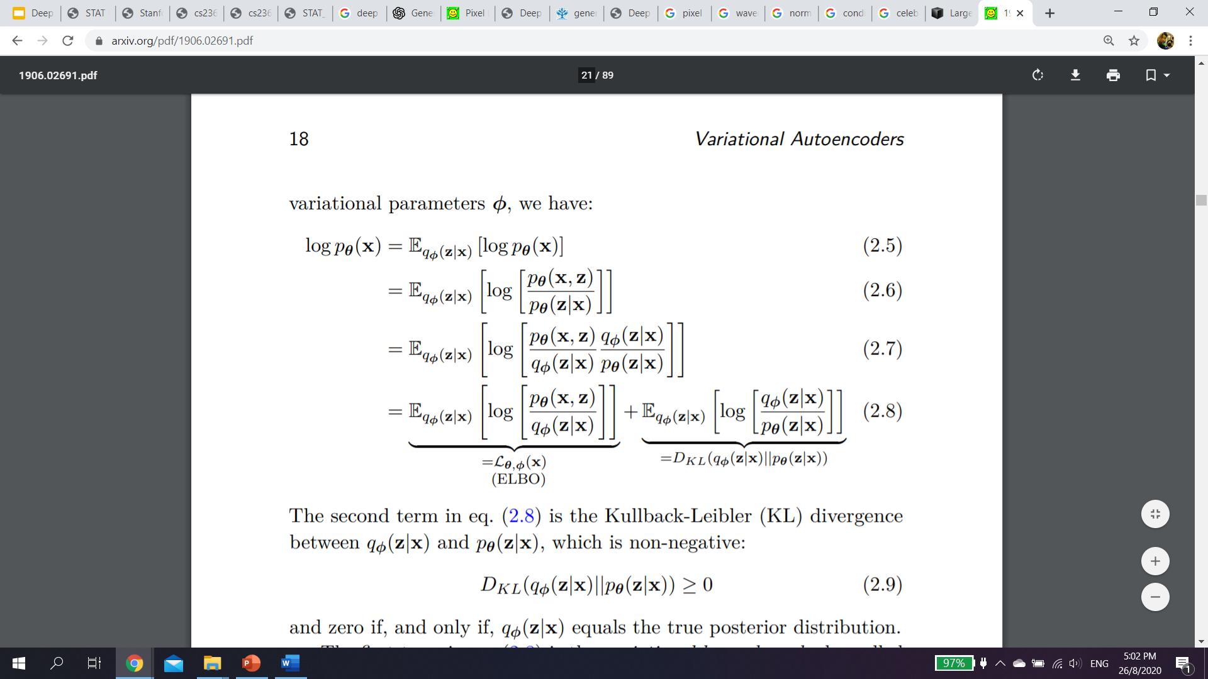
Evidence Lower BOund (ELBO)
Train to maximise:
Variational lower bound also known as ELBO
KL Divergence >= 0
Kingma, D. P., & Welling, M. (2019). An introduction to variational autoencoders. arXiv preprint arXiv:1906.02691.

Slide 18
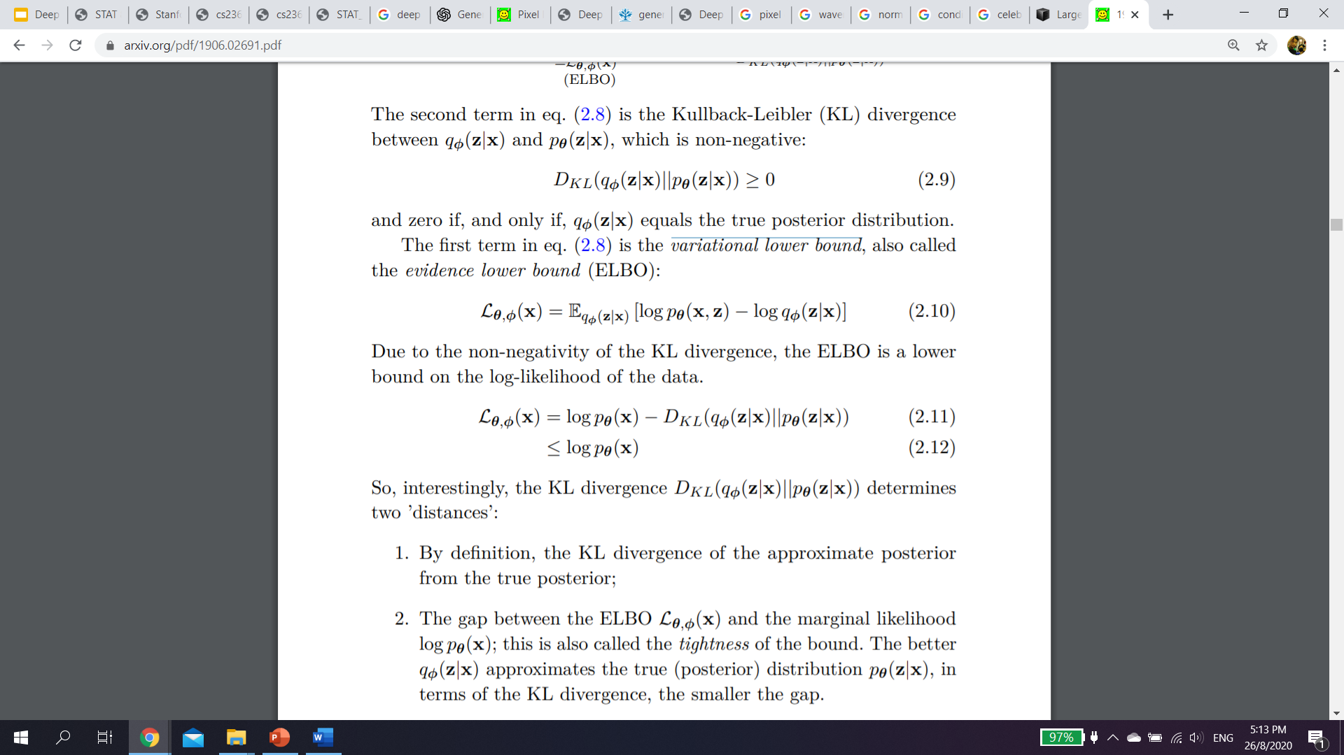
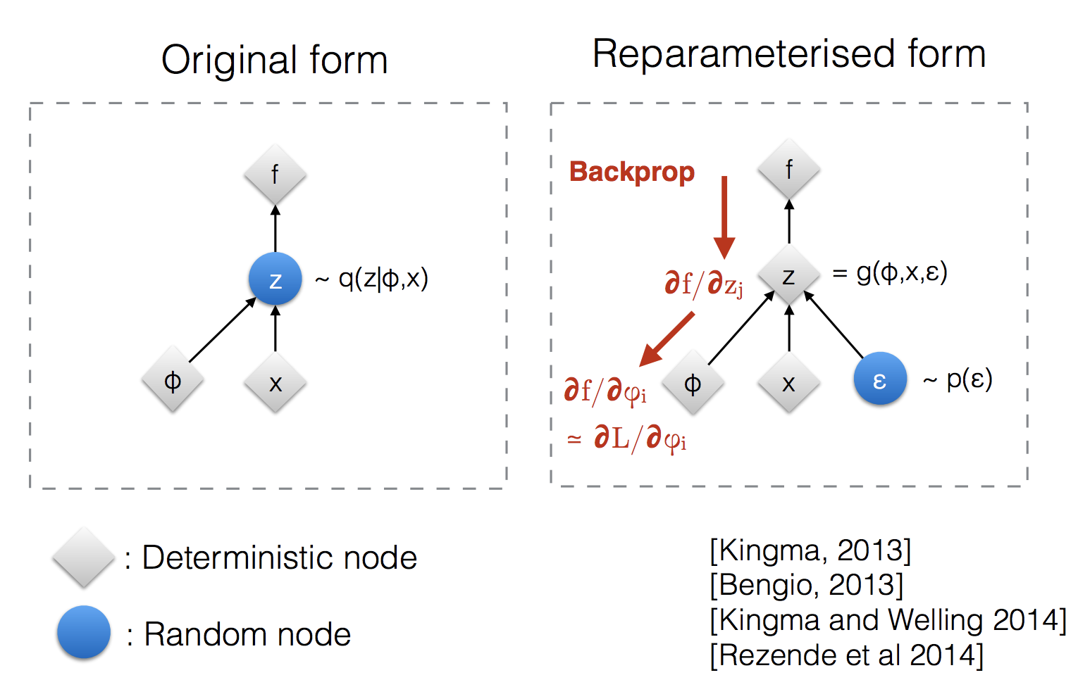
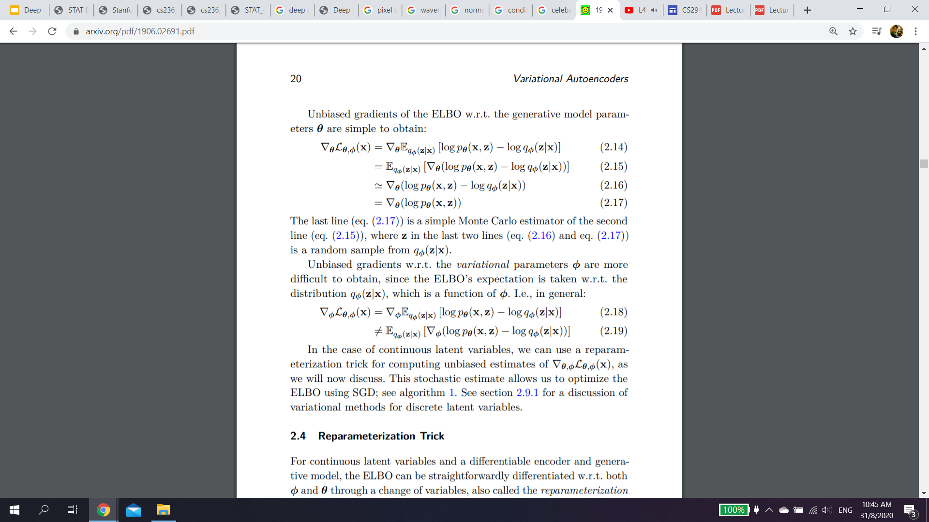
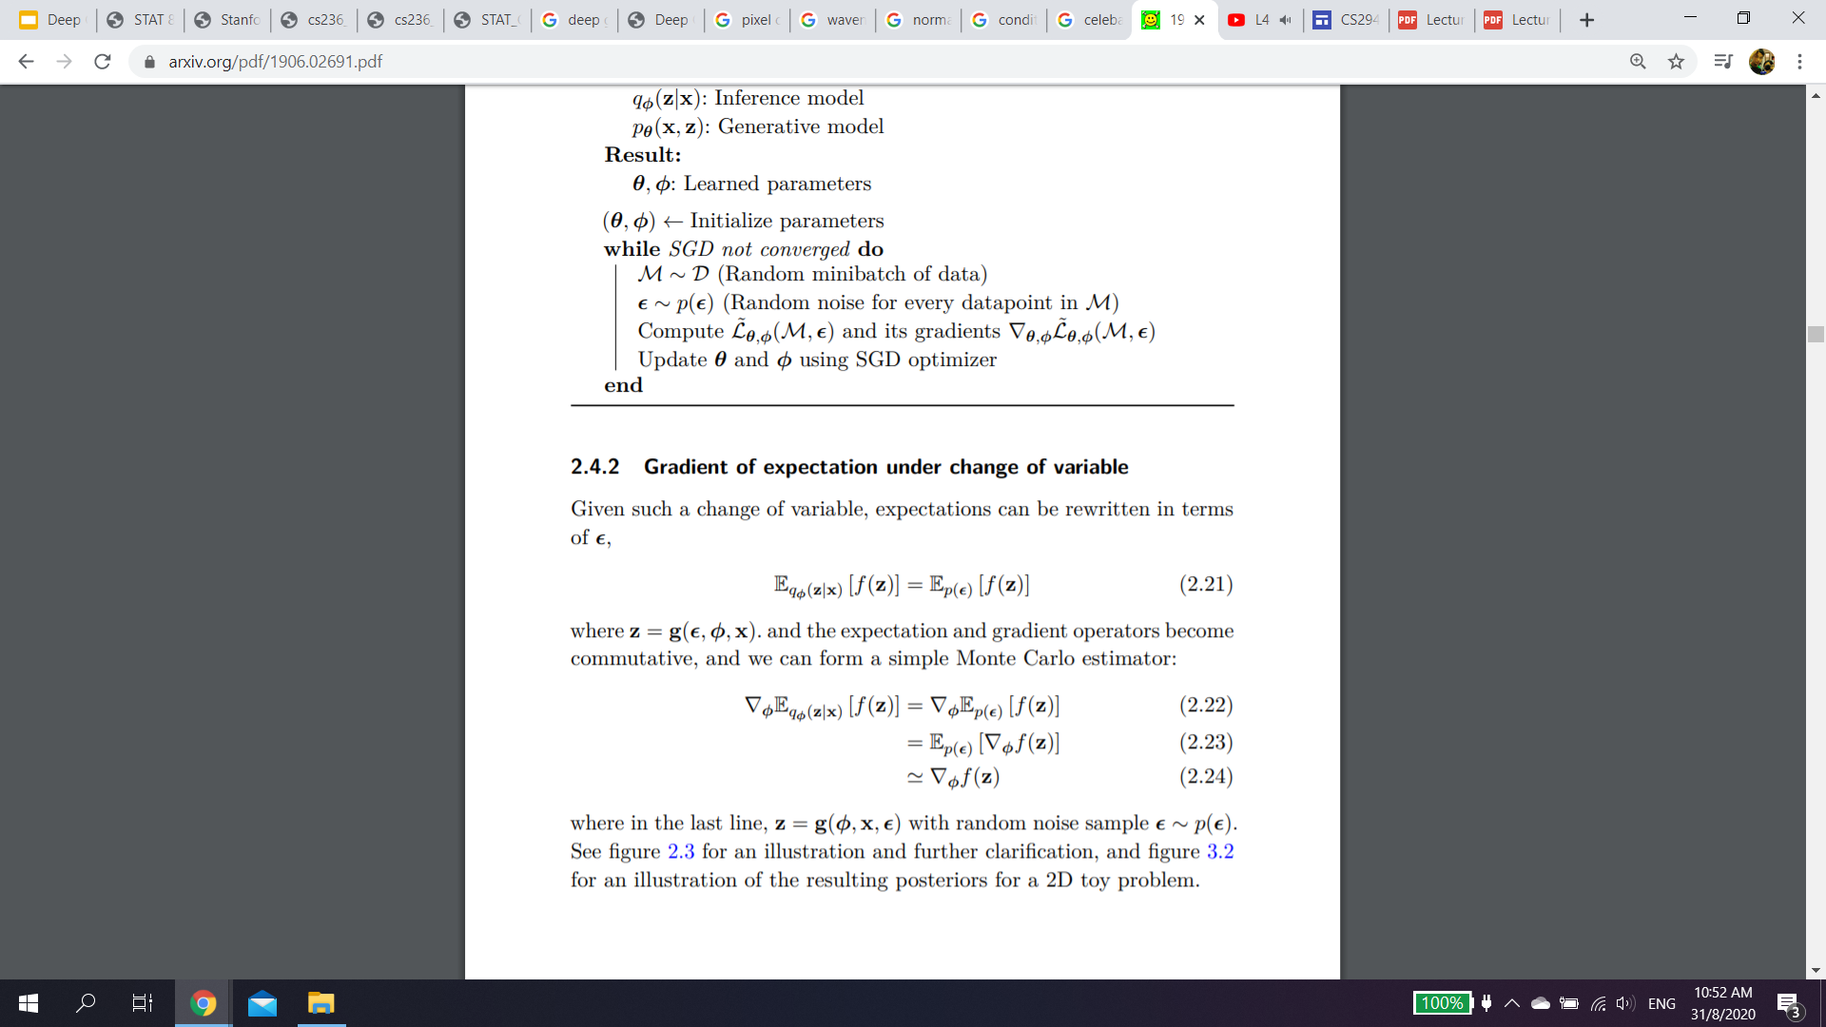
Evidence Lower Bound (ELBO)
ELBO:
Due to the non-negativity of the KL divergence, the ELBO is a lower bound on the log-likelihood of the data.
The gap between the ELBO L_{θ,φ}(x) and the marginal likelihood log p_{θ}(x); this is also called the tightness of the bound. The better q_{φ}(z|x) approximates the true (posterior) distribution p_{θ}(z|x), in terms of the KL divergence, the smaller the gap.
Generator Parameters θ Gradient
Variational Parameters φ Gradient
where in the last line, z = g(φ, x, ε) with random noise sample ε ∼ p(ε).
where z in the last two lines is a random sample from q_{φ}(z|x).
Kingma, D. P., & Welling, M. (2019). An introduction to variational autoencoders. arXiv preprint arXiv:1906.02691.

Slide 19
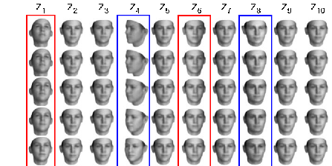
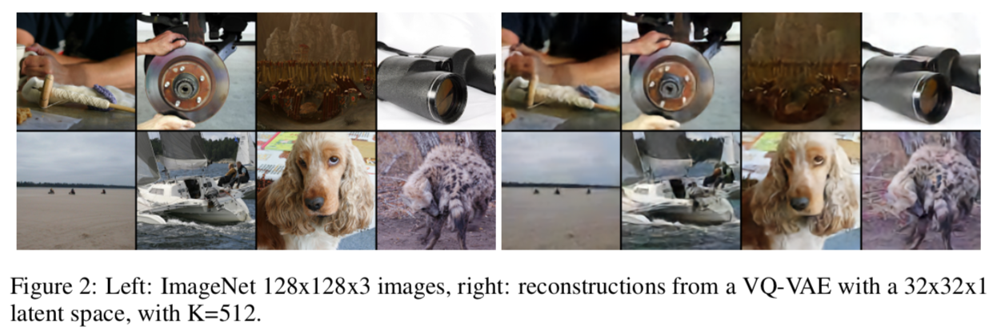
Examples of VAEs
Factor-VAE
Kim, H., & Mnih, A. (2018). Disentangling by factorising. arXiv preprint arXiv:1802.05983.
Van Den Oord, Aaron, and Oriol Vinyals. "Neural discrete representation learning." Advances in Neural Information Processing Systems. 2017.
Notes:
Factor VAE: Encourage independent across the latent dimensions
VQ-VAE: encoder output discrete codes rather than continuous (vector-quantized VAE)

Slide 20
Variational Autoencoders
Directed model permits ancestral sampling (efficient generation): z ∼ p(z), x ∼ p(x|z; θ)
However, log-likelihood is generally intractable, hence learning is difficult
Joint learning of a model (θ) and an amortized inference component (φ) to achieve tractability via ELBO optimization
Latent representations for any x can be inferred via q_{φ}(z|x)
Slide adapted from http://cs236.stanford.edu/syllabus.html

Slide 21
Variational Autoencoders
Pros:
Easy to build flexible models
Suitable for unsupervised learning
Cons:
Hard to evaluate likelihoods
Hard to train via maximum-likelihood
Fundamentally, the challenge is that posterior inference p(z | x) is hard. Typically requires variational approximations
Alternative: give up on KL-divergence and likelihood (GANs)
Slide adapted from http://cs236.stanford.edu/syllabus.html

Slide 22
Normalizing Flow Models
Autoregressive models provide tractable likelihoods but no direct mechanism for learning features
Variational autoencoders can learn feature representations (via latent variables z) but have intractable marginal likelihoods
Key question: Can we design a latent variable model with tractable likelihoods? Yes!
Slide adapted from http://cs236.stanford.edu/syllabus.html

Slide 23
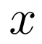
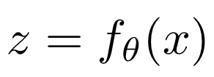
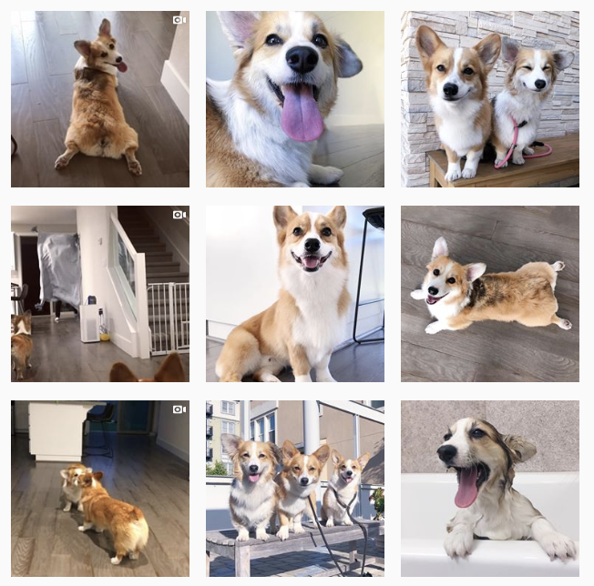
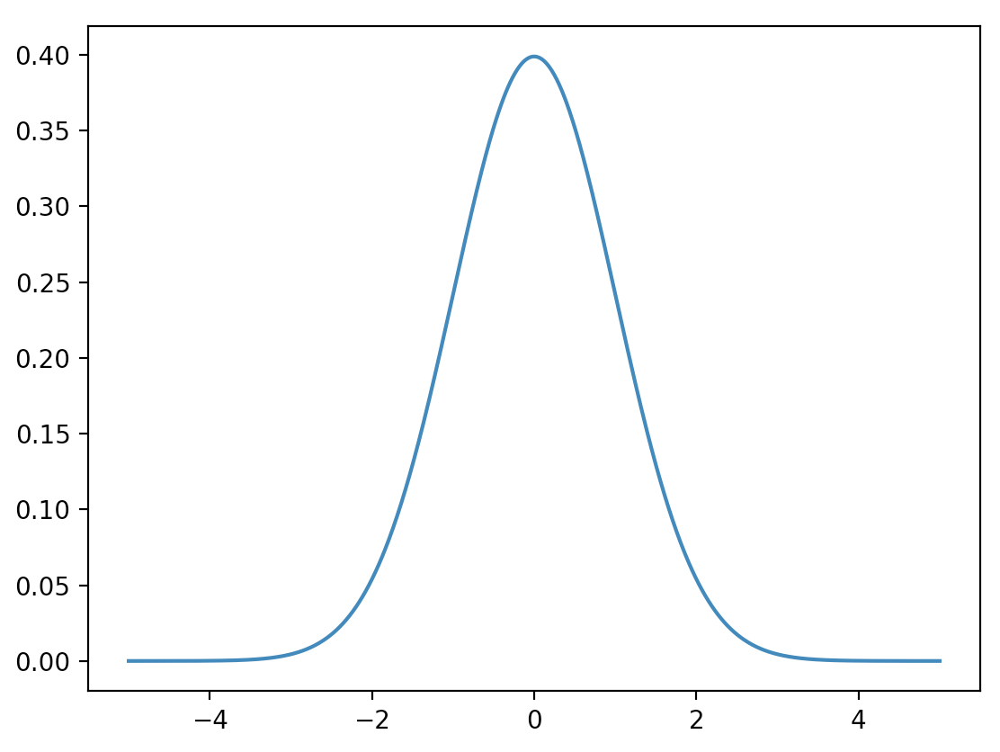
Normalizing Flow Models
...
f (inference)
f⁻¹ (sampling)
x and z must have the same dimension.
Slides from https://sites.google.com/view/berkeley-cs294-158-sp20/home

Slide 24
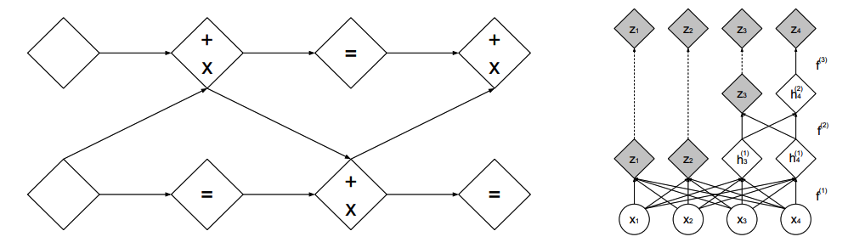
Normalizing Flow Models
Function must be invertible and differentiable.
Triangular Jacobian permits efficient evaluation of log-likelihoods.
Dinh, L., Sohl-Dickstein, J., & Bengio, S. (2016). Density estimation using real nvp. arXiv preprint arXiv:1605.08803.

Slide 25


Illustration of Normalizing Flow Model
Dinh, L., Sohl-Dickstein, J., & Bengio, S. (2016). Density estimation using real nvp. arXiv preprint arXiv:1605.08803.
https://lilianweng.github.io/lil-log/2018/10/13/flow-based-deep-generative-models.html#what-is-normalizing-flows

Slide 26


Example of Flow Models
GLOW
Real-NVP
Dinh, L., Sohl-Dickstein, J., & Bengio, S. (2016). Density estimation using real nvp. arXiv preprint arXiv:1605.08803.
Kingma, Durk P., and Prafulla Dhariwal. "Glow: Generative flow with invertible 1x1 convolutions." Advances in neural information processing systems. 2018.

Slide 27
Normalizing Flow Models
Transform simple distributions into more complex distributions via change of variables
Function must be invertible and differentiable
Jacobian of transformations should have tractable determinant for efficient learning and density estimation
Slide adapted from http://cs236.stanford.edu/syllabus.html

Slide 28
Generative Adversarial Networks (GANs)
Previous methods are based on maximizing likelihoods (or approximations).
What if you only care about sampling?
You want to build a generative model that can understand the underlying distribution of data points and
smoothly interpolate across the training samples
output samples similar but not the same as training data samples
output samples representative of the underlying factors of variation in the training distribution.
Example: digits with unseen strokes, faces with unseen poses, etc.
Slides from https://sites.google.com/view/berkeley-cs294-158-sp20/home

Slide 29

Generative Adversarial Networks (GANs)
Two-sample test objectives allow for learning generative models only via samples (likelihood-free).
Goodfellow, Ian, et al. "Generative adversarial nets." Advances in neural information processing systems. 2014.

Slide 30
Generative Adversarial Networks (GANs)
Two player minimax game between generator (G) and discriminator (D)
(D) tries to maximize the log-likelihood for the binary classification problem
data: real (1)
generated: fake (0)
(G) tries to minimize the log-probability of its samples being classified as “fake” by the discriminator (D)
Slides from https://sites.google.com/view/berkeley-cs294-158-sp20/home

Slide 31


Examples of GAN
1024x1024 pixels
Slides from https://sites.google.com/view/berkeley-cs294-158-sp20/home
Karras, Tero, et al. "Progressive growing of gans for improved quality, stability, and variation." arXiv preprint arXiv:1710.10196 (2017).

Slide 32
Current Challenges - Issues with GANs
However, working with GANs can be very challenging in practice
Unstable optimization
Mode collapse
Evaluation
Many bag of tricks applied to train GANs successfully
Slide adapted from http://cs236.stanford.edu/syllabus.html

Slide 33

Unstable Optimization
Mescheder, L., Geiger, A., & Nowozin, S. (2018). Which training methods for GANs do actually converge?. arXiv preprint arXiv:1801.04406.

Slide 34

Mode Collapse
Standard GAN training collapses when the true distribution is a mixture of gaussians (Figure from Metz et al 2016)
Slides from https://sites.google.com/view/berkeley-cs294-158-sp20/home

Slide 35

VQ-VAE 2.0 vs BigGAN Deep
Slides from https://sites.google.com/view/berkeley-cs294-158-sp20/home

Slide 36

Evaluating GAN
Inception Score (IS) ↑
Use trained Inception Network v3, p(y|x), y is one of the 1000 ImageNet classes
Each image x should have distinctly recognizable object -> p(y|x) should have low entropy
There should be as many classes generated as possible -> p(y) should have high entropy
Fréchet Inception Distance (FID) ↓
proposed to capture diversity
Compare mean (m) & covariance © between features from generated vs real data
Still an open problem to have a good evaluation metric for GANs.
Slides from https://sites.google.com/view/berkeley-cs294-158-sp20/home

Slide 37



Current Challenges - Out of Distribution Detection
Flow models that compute an exact likelihood often assign higher likelihood to out-of-distribution data than the data used for maximum likelihood training. The fundamental reasons for why flows fail at OOD detection in the first place are not fully understood.
SVHN
ImageNet
Polina Kirichenko, Pavel Izmailov, Andrew Gordon Wilson (2020) Why Normalizing Flows Fail to Detect Out-of-Distribution Data https://arxiv.org/abs/2006.08545

Slide 38



Applications to Robotics
Self-Supervised Learning
Model-Based Reinforcement Learning
E.g. Grasping, Navigation, Interaction.
World Models (Ha D. et al, 2018)
Visual Foresight (Ebert F. et al, 2018)
Ha, David, and Jürgen Schmidhuber. "World models." arXiv preprint arXiv:1803.10122 (2018).
Ebert, Frederik, et al. "Visual foresight: Model-based deep reinforcement learning for vision-based robotic control." arXiv preprint arXiv:1812.00568 (2018).

Slide 39

Current SOTA
Esser, Patrick, Robin Rombach, and Bjorn Ommer. "Taming transformers for high-resolution image synthesis." Proceedings of the IEEE/CVF Conference on Computer Vision and Pattern Recognition. 2021.

Slide 40
Summary
What are Deep Generative Models (DGMs)?
Types of DGMs
Fully Observable Likelihood models
Autoregressive Models
Normalizing Flows Models
Latent Variable Models
Variational Autoencoders (VAEs)
Implicit Generative Models
Generative Adversarial Networks (GANs)
Current Challenges

Slide 41
References
http://cs236.stanford.edu/syllabus.html
https://deepgenerativemodels.github.io/notes/index.html
http://stat.columbia.edu/~cunningham/teaching/GR8201/#:~:text=Course%20Description,learning%20of%20deep%20neural%20networks.
https://cs.nyu.edu/courses/spring18/CSCI-GA.3033-022/
https://openai.com/blog/generative-models/
http://www.sci.utah.edu/~shireen/deep_generative_models.html
https://www.youtube.com/watch?v=FMuvUZXMzKM
https://sites.google.com/view/berkeley-cs294-158-sp20/home

